Slide 1
Welcome Parents of
Mayfield High School
Class of 2023
8TH TO 9TH GRADE
SCHEDULING PROGRAM

Slide 2
Mr. Linn
ASSISTANT PRINCIPAL FOR STUDENT AFFAIRS – GRADES 9 & 10

Slide 3
Agenda
Being a successful Wildcat
Clubs, Sports, & Organizations
Introduction to Counselors
Graduation Requirements
The Scheduling Process
Q & A with Administrators and School Counselors

Slide 4
How to be Successful at MHS
What advice do you wish someone would have given you before you started your freshman year at Mayfield High School?

Slide 5
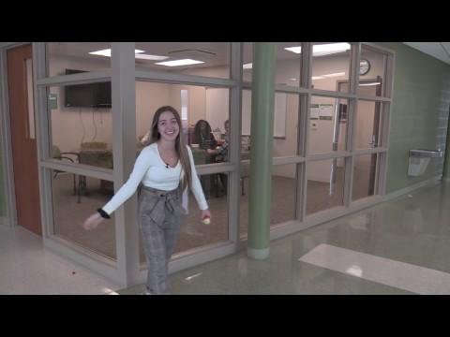

Slide 6
How to be successful at MHS
Be Invested & Involved
Academics, Clubs, Sports, & Philanthropy
Be Organized & Self Aware
Be Connected
Peers, Teachers, Counselors, Administrators, & all Staff

Slide 8
People who are always happy to help
Teachers
Administrators
Support Staff
School Counselors
Media Center Specialist
All of us

Slide 9
Clubs & Activities
Art Club
Career Technical Education
Cats Cabinet
Catettes & Flags
Chess Club
Film Club
Interact Club
Mayfield Theater Company
Mock Trial
NHS
Peace Corp
P.R.I.D.E
Science Olympiad
Ski Club
Student Council
Video Game Club
Wildcat Focus Mentors
World Affairs Club
G.S.A.

Slide 10
Athletic Programs
Boys
Girls
Baseball
Basketball
Bowling
Cross Country
Football
Golf
Ice Hockey
Indoor Track
Soccer
Swimming & Diving
Tennis
Track
Wrestling
Basketball
Cheerleading
Cross Country
Bowling
Fast Pitch
Gymnastics
Golf
Indoor Track
Soccer
Swimming & Diving
Tennis
Track
Volleyball

Slide 11
Parent Organizations
Academic Boosters
After Prom Committee
Athletic Boosters
Band Boosters
Parent Mentor Program
P.T.S.O

Slide 12
Learning Modalities @ MHS
Traditional
Cross Curricular
Self-Paced
On-Line

Slide 13
Learning Modalities/Classes for 9th grade
Self Paced Algebra 1
Self Paced Info. Tech

Slide 14
Mrs. Bourdakos Yost
SCHOOL COUNSELOR

Slide 15
School Counseling Department
Counselor | Last Names: | Contact Information
Ms. Levy | A – E | (440)995-6823 Dlevy@mayfieldschools.org
Mrs. Bourdakos Yost | F – L | (440)995-6956 Mbourdakos@mayfieldschools.org
Ms. McBride | M – R | (440)995-6917 Rmcbride@mayfieldschools.org
Mrs. Bobinski | S - Z | (440)995-6754 Pbobinski@mayfieldschools.org

Slide 16
School Counseling Department Continued...
Mr. Joe Hayes
Denise Valentino & Peggy Konieczny
CBI & non Mayfield students attending Mayfield programs
JHayes@mayfieldschools.org
440.995.6761
School Counseling Secretaries
440.995.6820

Slide 17
The Role of your School Counselor
Advocate for Students & Families
Social & Emotional Support
Academic Support
Career/College Planning

Slide 18
The Scheduling Process
Student Selection & Parental Feedback
MMS Course Recommendations
School Counselor Input
9th Grade Schedule

Slide 19
MHS Course Catalog
Information on Courses & Graduation Requirements
Career Information & Suggested Courses
Detailed Course Descriptions by Department
Grading Scales
Special Programs
Technical Education/Excel TECC Programs

Slide 20
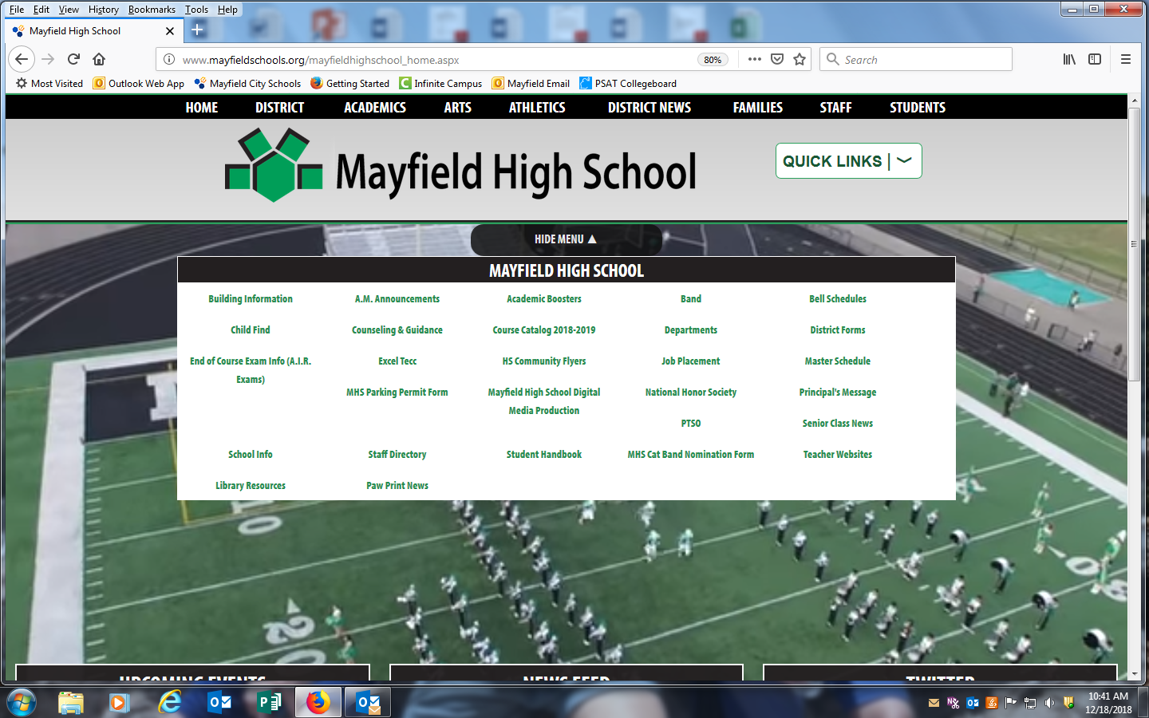

Slide 21
Currently in IC
8th grade teachers have populated core classes
Students are scheduling P.E., technology, fine arts languages, or electives
If they would like to change a core class, they will need to complete an override form
Minimum credits 5.75

Slide 22
Overriding a Class
Forms with MHS Counselors & Mrs. Borden at MMS
Read the override form carefully
Fill out & return to MHS Counselor or Mrs. Borden
Moving from one level to another
Example: English 1 to English 1 Honors
English 1 Honors to English 1

Slide 24
Moving Forward
Q & A with School Counselors & Administrators
Beginning tomorrow, School Counselors back @ MMS to begin one on one scheduling
Check email regularly for any updates
Be sure to log into your School Counseling Google Classroom for Class of 2023 with code: ot0v9b2
Follow us on Twitter @mayfieldcounsel

